Slide 1
A Site Administrator’s Guide:
Talking to Parents
About the California Alternate Assessments (CAAs)

Slide 2
The Intent of This Deck
  This slide deck is intended for use by site administrators to provide information to Parents about the CAA for English-language arts (ELA), mathematics, and science. It includes:
    A description of why the CAAs are given
    An overview of test administration
    Information on who takes the CAAs
    When the tests are administered
    Information on how test results are reported
    Available resources for parents related to the CAAs

Slide 3
Recommended Handouts
Parent Guide to Understanding
  Available in seven languages
  https://www.cde.ca.gov/ta/tg/ca/documents/caapgtu.pdf
Take a Practice and Training Test with Your Child
  http://www.caaspp.org/practice-and-training/index.html
  How to Take a Practice Test Quick Reference Guide
  https://www.cde.ca.gov/ta/tg/ca/documents/caaqrgpractice.pdf

Slide 4
How to Use This Deck (1)
This deck has been created for you to customize and edit as needed:
  Choose the slides you want to use.
    Select the “View” tab, and then select “Normal.”
    In the slide list on left, right-click on the slide you do not want and select “Hide Slide” at the bottom of the menu.
  Add your school’s logo and change colors.
  Change wording for your audience−you know your audience best!
  Talking points are provided in the “Notes” section that can be customized to your audience.

Slide 5
How to Use This Deck (2)
  Change color scheme.
    Select “View” tab, and then “Slide Master.”
      - For titles, select slide ─ highlight header text ─ select “Home” tab ─ choose text color ─ return to “View” tab.
      - For the body, select slide ─ highlight body text ─ select “Home” tab ─ choose text color ─ return to “View” tab.
      - For the green line, select slide ─ highlight line ─ select “Home” tab ─ select “Shape Outline” ─ choose color ─ return to “View” tab.
      - When all changes are made ─ select “Slide Master” tab ─ select “Close Master View.”
  The changes should apply to all slides in the deck.

Slide 6
Understanding the California Alternate Assessments (CAAs)
[Add school logo here, if desired.]
[Add school motto here, if desired.]

Slide 7
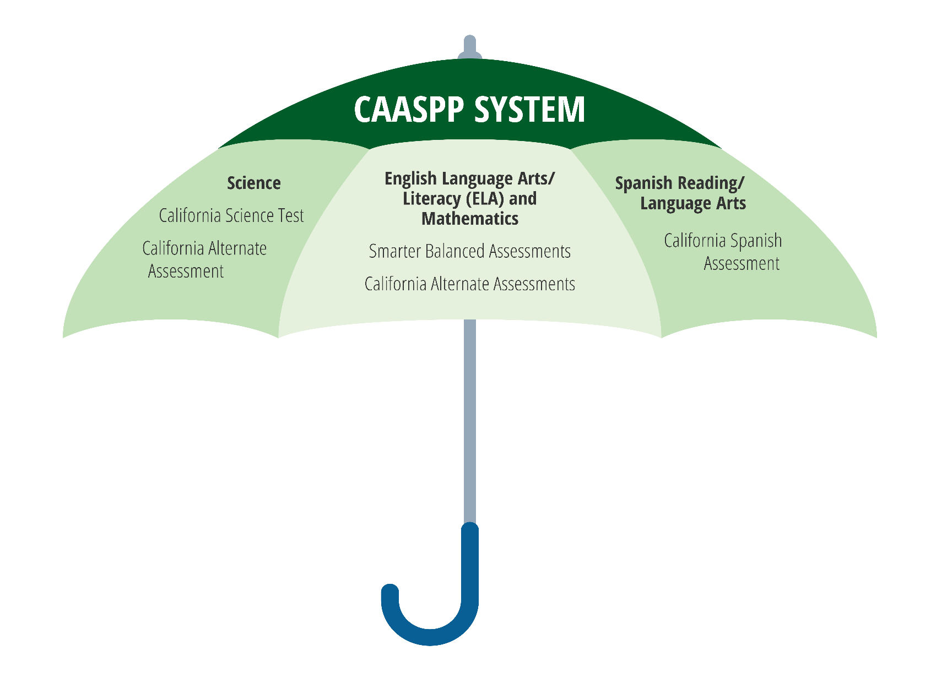
CAASPP System

Slide 8

Why:
To allow students with the most significant cognitive disabilities to show what they know and can do.

Slide 9

What:
English-language arts
Mathematics
Science

Slide 10

How:
On a computer
With a trained
test examiner
One-on-one setting

Slide 11
CAA for ELA and Math

Slide 12

Who: ELA/Math

Slide 13


When: ELA/Math

Slide 14
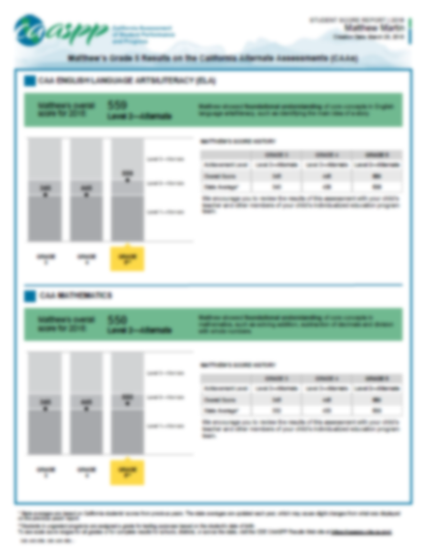
Scores:
ELA/Math

Slide 15
CAA for Science

Slide 16
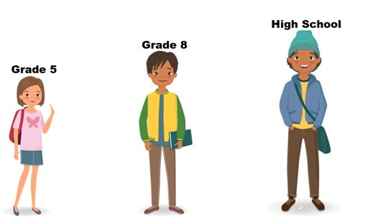
Who:

Slide 17

Three Areas of Study

Slide 18
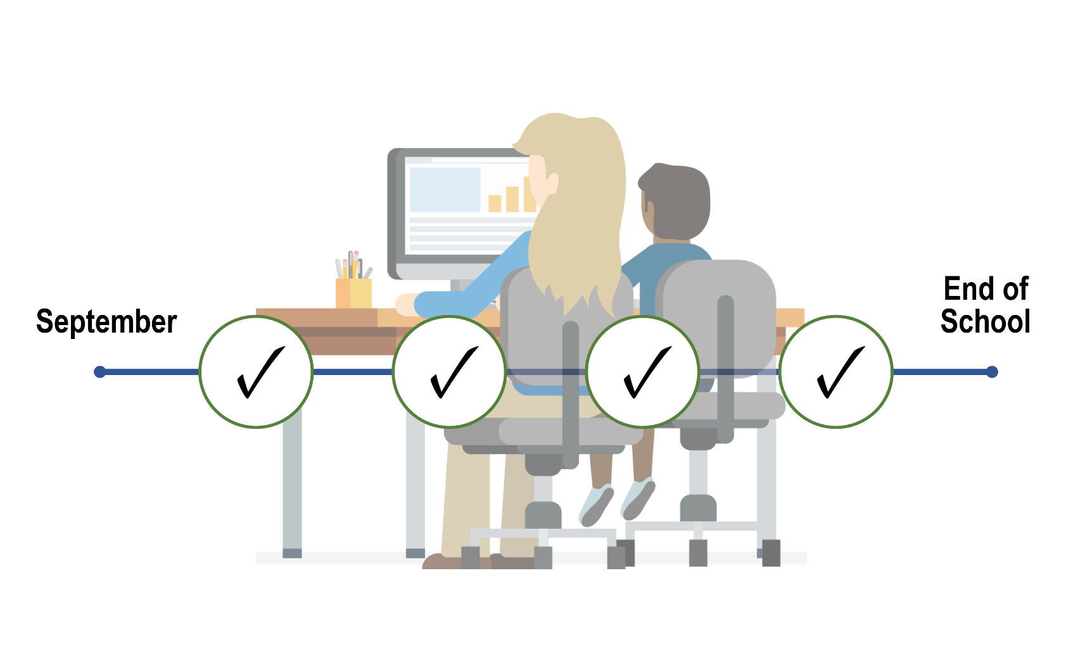
When:

Slide 19

Scores:
2020‒21 operational test: complete student scores

Slide 20

How Parents Can Help

Slide 21

Ask Your Child’s Teacher:
In what areas is my child doing well?
In what areas might my child need some extra support?
How can I help support my child at home?
How are you supporting my child at school?

Slide 22

Help Your Child Succeed
Discuss the test with your child.
Set expectations.
Take a practice test with your child.
Make sure your child gets a good night’s sleep and a nutritious breakfast before testing.

Slide 23

Starting Smarter
https://ca.startingsmarter.org/

Slide 24
Learn More:
Parent/Guardian Guide to the CAA
  https://www.cde.ca.gov/ta/tg/ca/caaparentguide.asp
Parent’s Guide to Understanding the CAA
  https://www.cde.ca.gov/ta/tg/ca/documents/caapgtu.pdf
Available Resources for CAA for Science
  http://www.caaspp.org/ta-resources/available-resources-caasci.html
Student Interface Practice and Training Tests
  http://www.caaspp.org/practice-and-training/index.html
Starting Smarter
  https://ca.startingsmarter.org/

Slide 25

Questions

Slide 26
Posted by the California Department of Education | August 2020

